Slide 1

PageUp User Guide
Requisition Process, Job Posting and Applicant Management
Human Resources Department
People and Workplace Culture
Notes:
Note, these pptx modules are to be viewed from the perspective of the hiring manager.

Slide 2
Table of Contents
Introduction - slide 3
How to log into PageUp - slide 4
Requisition Approval Process - slide 6
How to Manage Applicants and Move Through the Workflow - slide 17
Launching an Offer Card - slide 28
Finalizing Search & Extending Offer – slide 33

Slide 3
Introduction
Welcome to Colorado College's PageUp User Guide: Staff Edition
The purpose of this user guide is to help provide clarification and increase efficiency with this applicant tracking system to ensure a smooth hiring process. If you have questions, concerns, or suggestions for the PageUp User Guide, please contact the Talent Acquisition team, T'yah Macon (Interim Talent Acquisition Specialist) or Courtney Gibson (HR Coordinator, Recruitment and Performance Excellence).
At Colorado College, we are dedicated to dismantling systemic and institutional discrimination. We embrace diversity and support a community where all individuals, without exception, feel valued, empowered, and treated equitably. Guided by the College’s Antiracism Plan, we work to foster an equitable and inclusive environment for all who teach, learn, work, and live in our community.
Colorado College is committed to equal opportunity for all employees and applicants in all aspects of the employment relationship—including (but not limited to) recruiting, hiring, promotions, compensation, benefits, and access to training—without regard to race, creed, color, caste, religion, national origin, ancestry, sex (including pregnancy, gender identity or gender expression, perceived gender, sexual preferences and sexual orientation), disability, marital status, veteran status, age, genetic information, or any other status protected by federal, state, or local law.

Slide 4
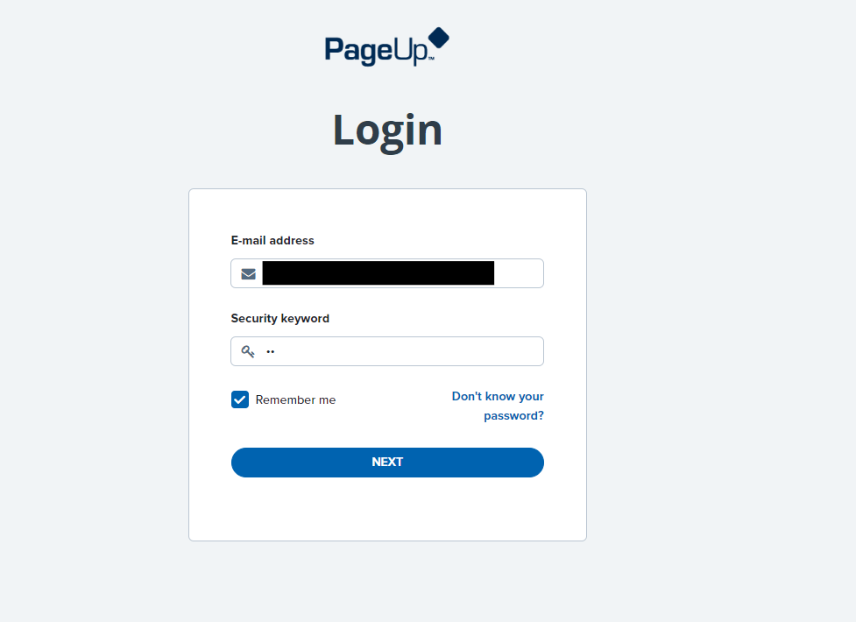
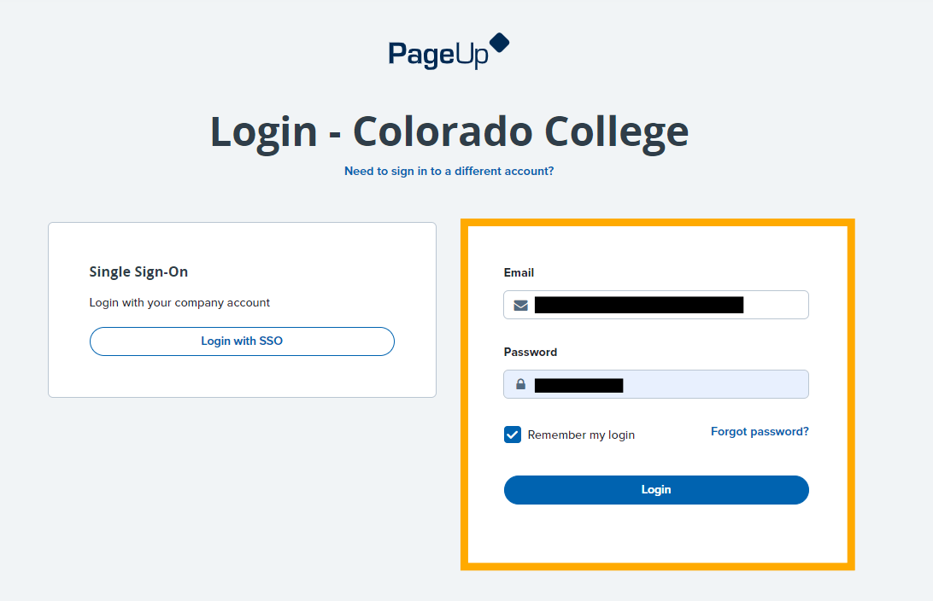
How to log into PageUp
You can view your job posting and dashboard on our new portal, PageUp!
Your login email is your CC email address, security code is cc (all lowercase, no spaces, no additional characters)
This will bring you to another sign in option. Do not sign in with your SSO; Your login email is your CC email address, your password is your regular CC password

Slide 5
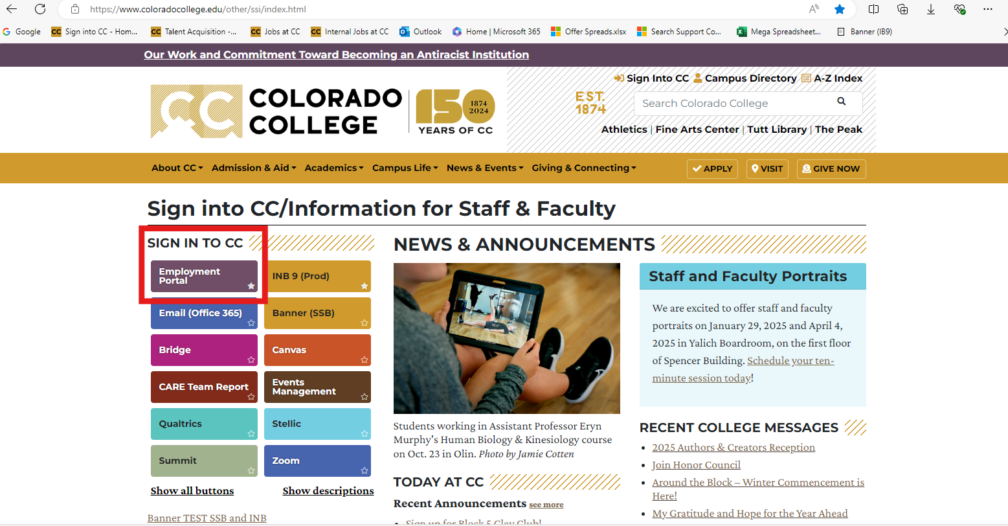
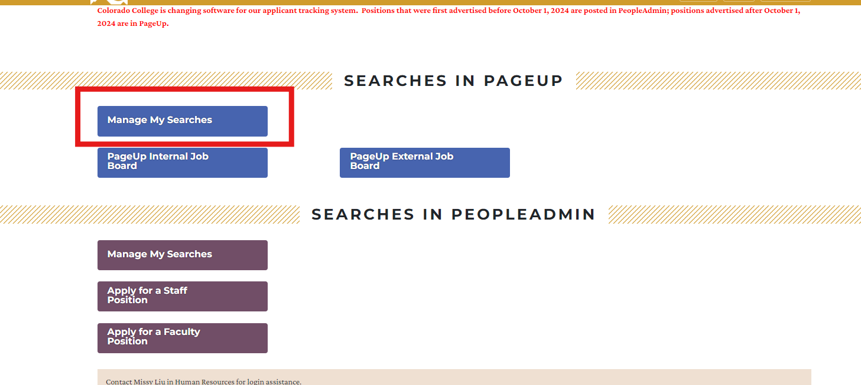
How to log into PageUp cont.
Note that this employment portal can also be found on CC's single sign-on and clicking on "Manage My Searches" (highly recommend bookmarking these pages)!

Slide 6
PageUp User Guide
Requisition Approval Process
Human Resources Department
People and Workplace Culture
Notes:
Note, these pptx modules are to be viewed from the perspective of the hiring manager.

Slide 7
Updating the Job Description
New Job Opportunity - New or Vacant Position (Internal or External Posting)
  To obtain the job description, please email Pam Butler.
  The job description will be sent through a link via email. This link will bring you to the PageUp portal where you can view and write comments on the job description.
  This email will come from HR's Talent Acquisition address (talentacquisition-1179@mail.pageuppeople.com)
Promotion or Significant Job Change (Internal Posting)
  When requesting an employee promotion or significant job change (title change, job responsibility updates, new pay, etc.) please email Pam Butler to obtain the job description.
  The job description will be sent through a link via email. This link will bring you to the PageUp portal where you can view and write comments on the job description.
    All job postings must be posted for 5 a minimum of days to comply with the Colorado Equal Pay for Equal Work Act.

Slide 8
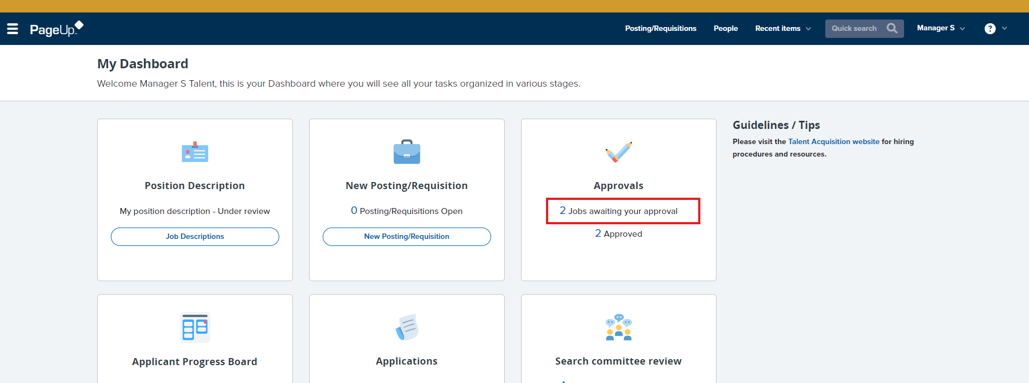
Step 2: Approving the Posting/Requisition Form
This is your dashboard. When a job is ready for you to approve it will show up under "Approvals." Click on "Jobs awaiting your approval."
HR will start the requisition and draft the posting (if applicable) then send requisition around for approvals. As you wait for final approver signatures, a member of our HR team will reach out to you to collect the Job Advertising Form, offer next steps and what to expect, as well as additional resources to aid you in your search. When the job posting requisition is ready to review, you will receive an email notification with the subject line "Requisition for Review".
To make any edits, cancel, reject, approve a requisition, log into PageUp People Login.

Slide 9
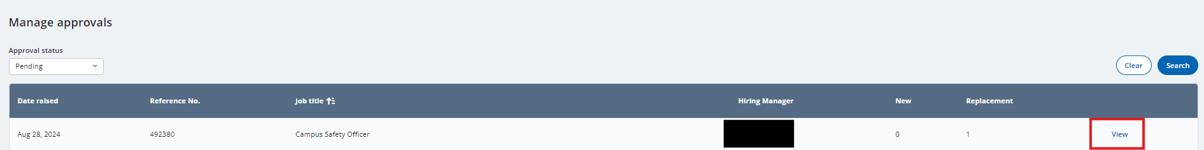
From here, click on "View" next to the job needing approval.

Slide 10
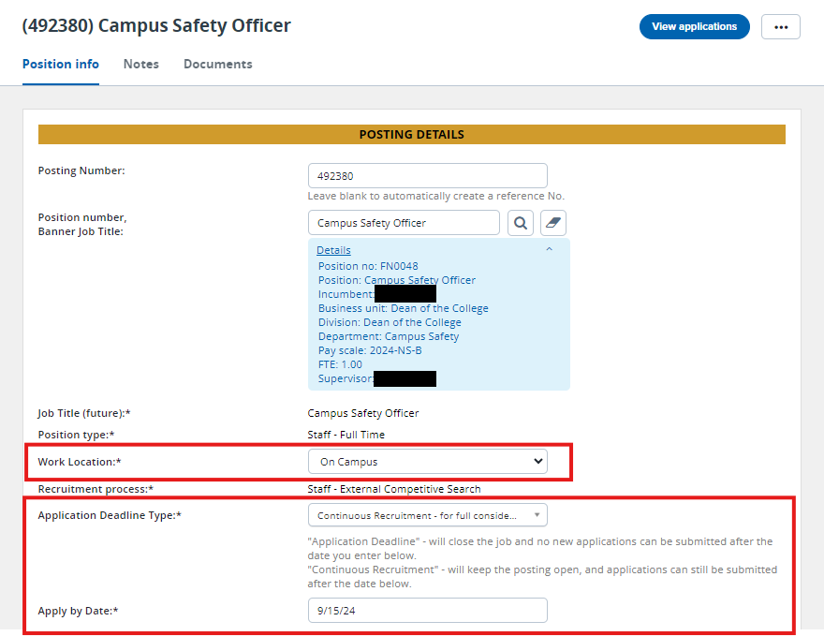
This will bring you to the Requisition. The first section is Posting Details. Please review the posting details and update the areas in red if needed.
Also, be sure to double check and/or update the "Apply by Date" before you approve.

Slide 11
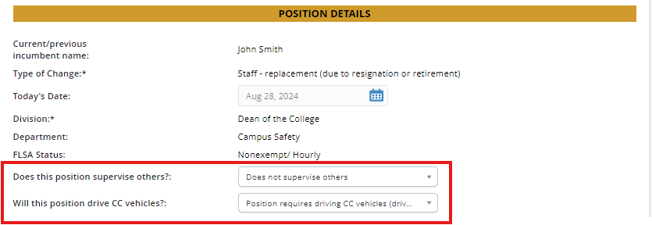
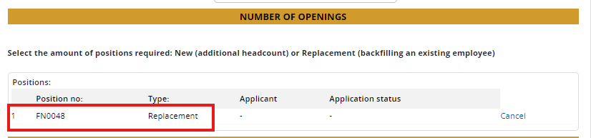
Requisition Updates Cont.
Next, is the Position Details section. Please make sure the details are correct and update the areas in red if needed (i.e. the number of openings).

Slide 12
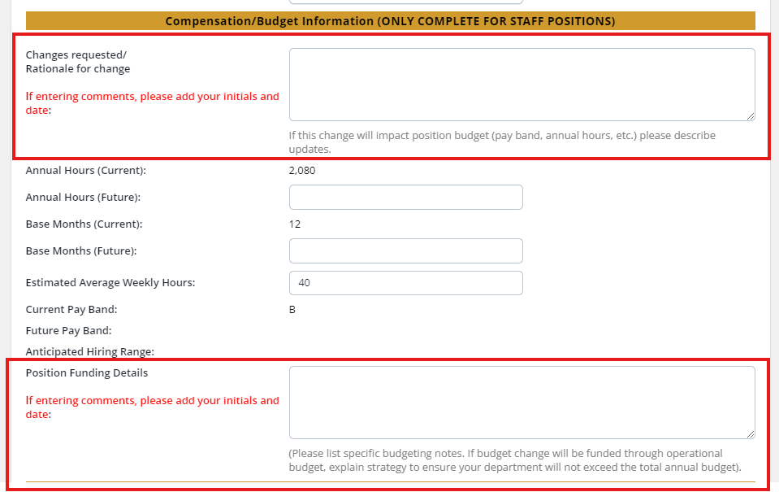
The compensation/budget information will have areas where you can make comments about changes requested/rationale for change, and position funding details if needed. Be sure to include your initials and date if leaving a comment.

Slide 13
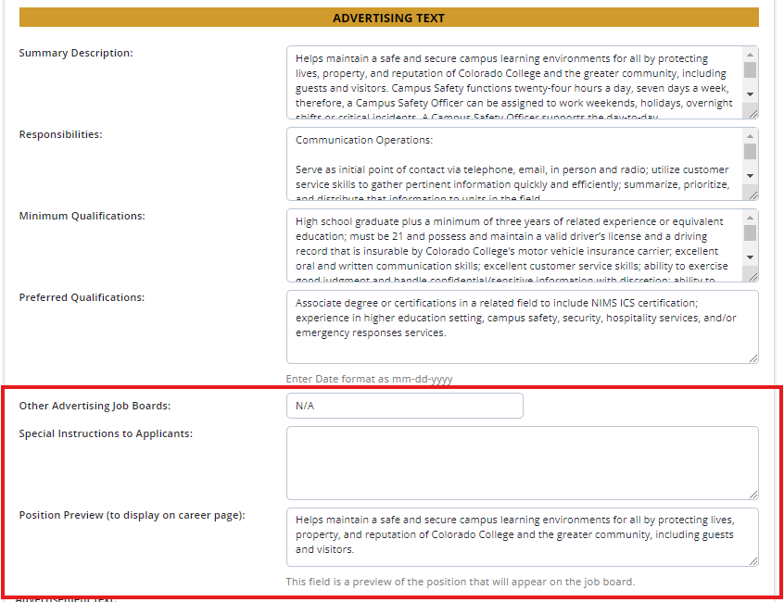
In the Advertising Text section, the summary description, responsibilities, minimum qualifications, and preferred qualifications are pulled from the job description. If you need to make changes to these areas, please do so in the next section or contact the Talent Acquistion Specialist directly.
Include any additional job boards you would like to post on (include URL) and special instructions to applicants.
Finally, for the position preview, include a few sentences about the position. This will show up on the career page as a preview to the applicant. Once they click on the job, they will see the full job posting.

Slide 14
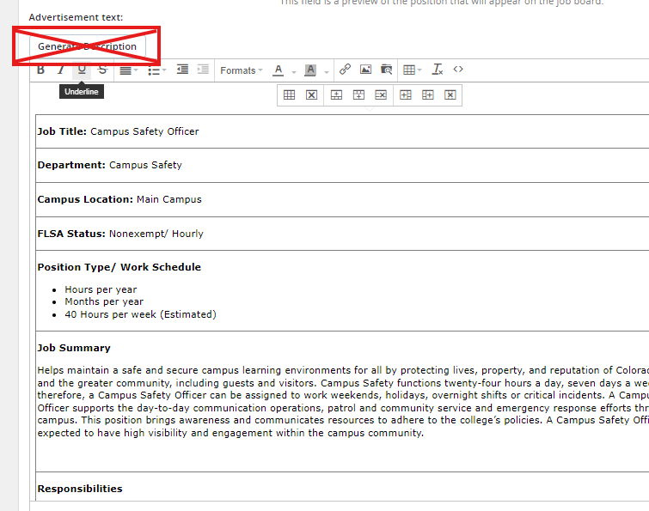
This advertisement text will show what will be posted on the job board. You can review and make any updates as needed in the section above; do not click "Generate Description". This will duplicate information.
If any updates are needed after you have approved the position, please reach out to the Talent Acquisition Specialist directly.

Slide 15
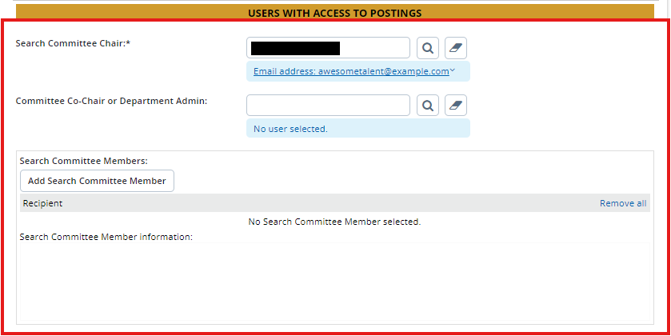
Next, select who will be the search committee chair, if not you. You can also select a committee co-chair or department administrator. This person will have access to move applicants through the workflow in PageUp.
Finally, select who will be serving on the search committee. If you are not sure, these can be added at a later time.

Slide 16
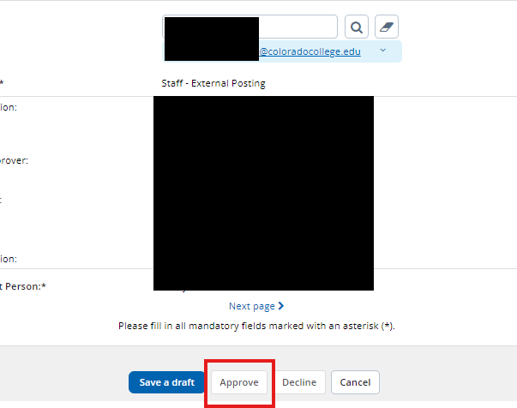
The last section on the requisition card shows the approval process (the hiring manager will typically see their name in step 2). After you have reviewed the posting and everything is to your liking, click "Approve" and it will go to the next person in the approval list.
When all the approval signatures are collected, the TA Spec. will then be notified to post the position, and an email will go to the hiring manager confirming it has been posted with additional next steps.

Slide 17
PageUp User Guide
Applicant Management and Moving through the Workflow
Human Resources Department
People and Workplace Culture
Notes:
Note, these pptx modules are to be viewed from the perspective of the hiring manager.

Slide 18
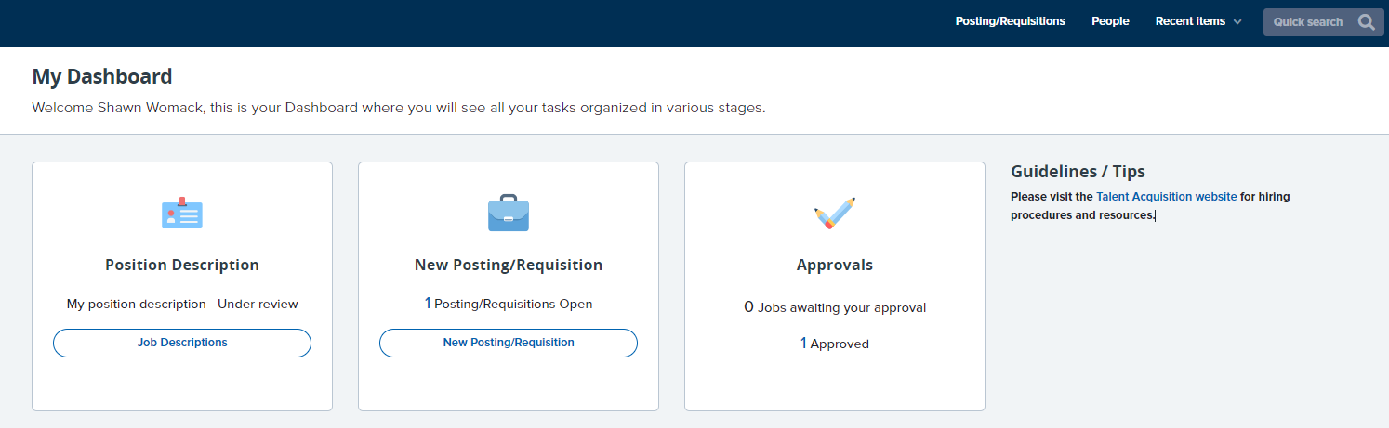
Viewing the job posting
Congratulations on your job posting!
After you receive a confirmation email from the Talent Acquisition Specialist (T'yah Macon) that the job has been posted, double check that you can see it by logging into PageUp, and viewing it from your dashboard. There are two ways to view this:
Option 1: Click "[number] Approved" in the Approvals box.
Option 2: Click "[number] Posting/Requisitions Open" in the New Posting/Requisition box.

Slide 19
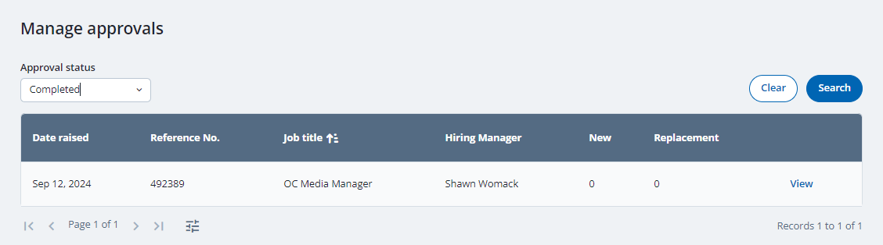
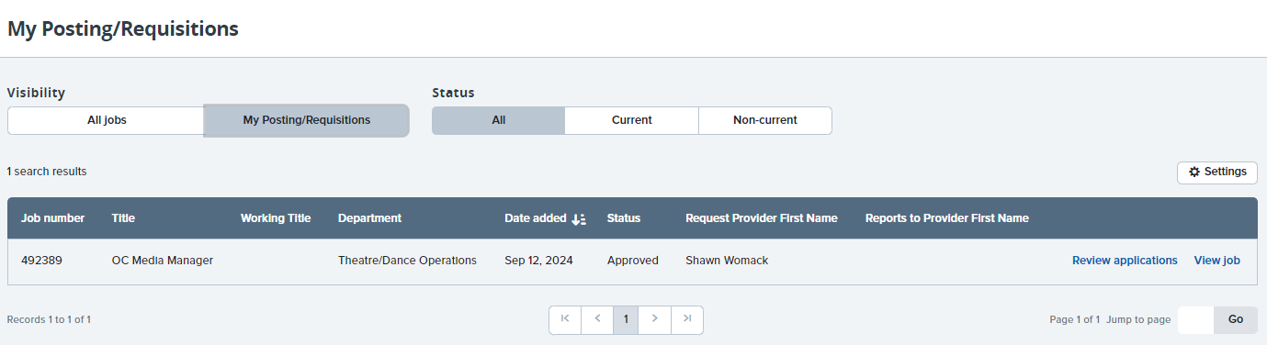
Viewing the job posting cont.
Option 1: Clicking " [number] Approved" in the approvals box. Select "View" to view the posting details, compensation info, advertising text, and more.
Note: In the "Approval status" drop down menu, select pending to view postings still in the approval process
Option 2: Clicking " [number] Posting/Requisitions Open" Select "View Job" to view the posting details, compensation info, advertising text, and more.
Note: Option 2 also provides a pathway to "Review Applications"

Slide 20
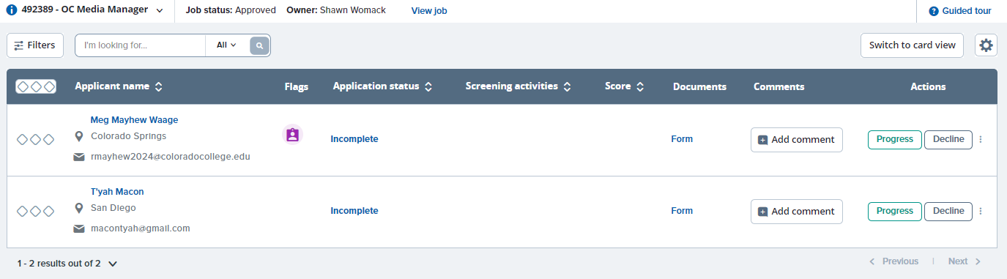
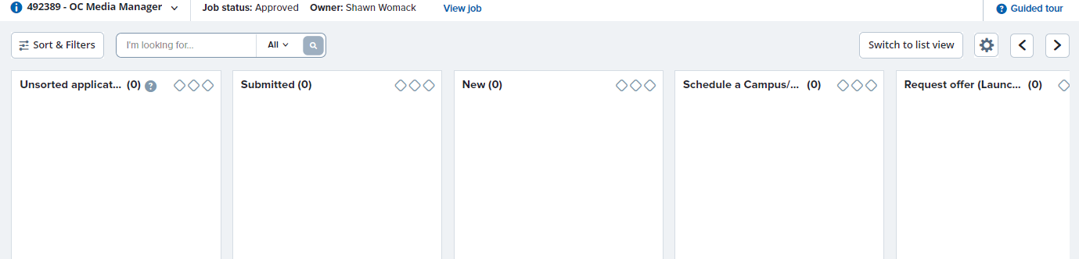
Viewing applicants
With any option, you will be able to customize your view of the applicant pool by either a List or Card view
Option 1: Clicking " [number] Posting/Requisitions Open select "Review Applications".
List View:
Note: To change view, select "Switch to ___"
Note: Utilize the "filters" feature to customize applicant search
Card View:

Slide 21
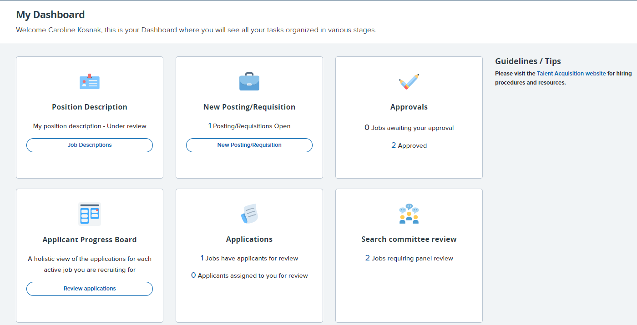
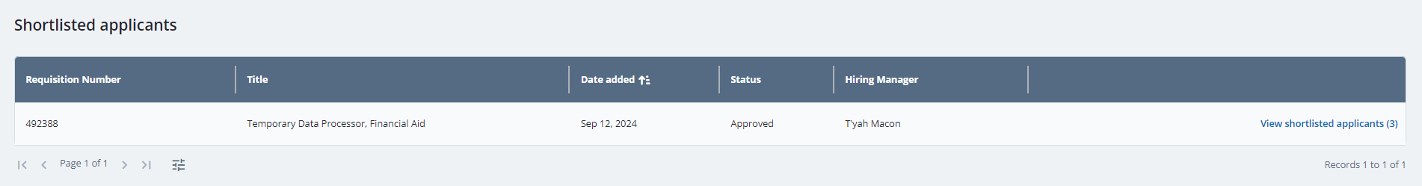
Viewing applicants cont.
Option 2: From your dashboard and in the "Applications box", select "[number] job have applicants for review"
Once selected, you will be able to view each position, and how many shortlisted applicants there are in the pool. Click "View Shortlisted Applicants" to view them.

Slide 22
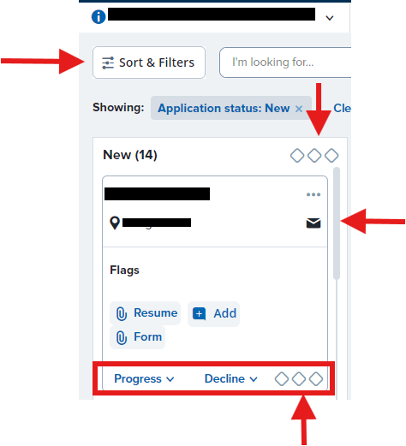
Viewing & managing applicants cont.
These three diamond-shaped ellipsis allows for mass coordination or to move multiple candidates at a time through the workflow. The bottom of your screen will present options to choose what to do with the selected individuals. To de-select all, press "Esc" on your keyboard.
Here, you can add filters to help you sort your candidates.
This icon takes you to the candidates contact information, or you can hover over the icon to see a quick view.
Key:
Left diamond = Green
Middle diamond = Yellow
Right diamond = Red
The three diamond-shaped ellipsis underneath the candidate's name allows for individual coordination, or one person at a time.

Slide 23
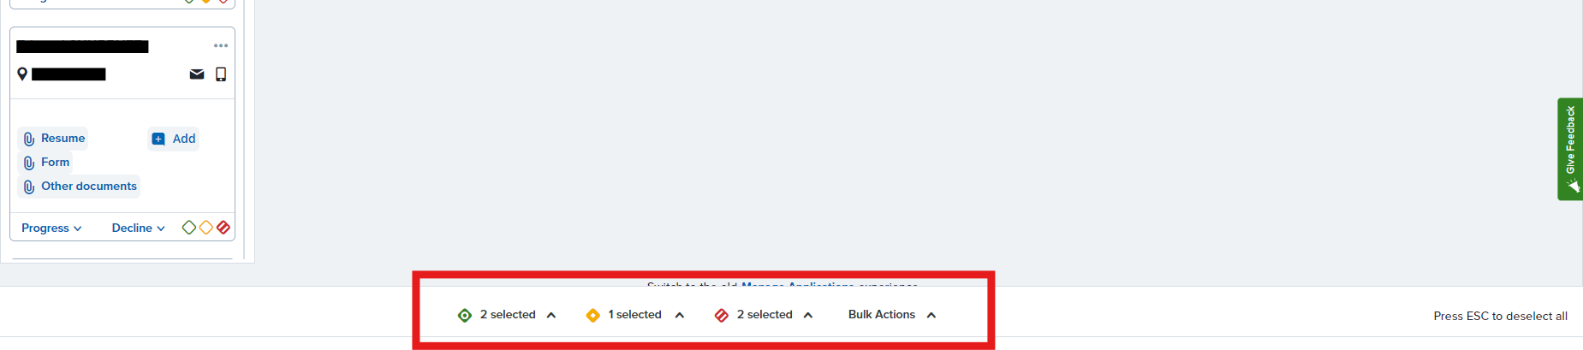
Bulk Functions
To perform a bulk action, select the coordination status you want to apply to individuals with that same status. For instance, when you mark individual applicants in green, the total number of green applicants will be displayed below, allowing you to take action on those specific applicants.

Slide 24
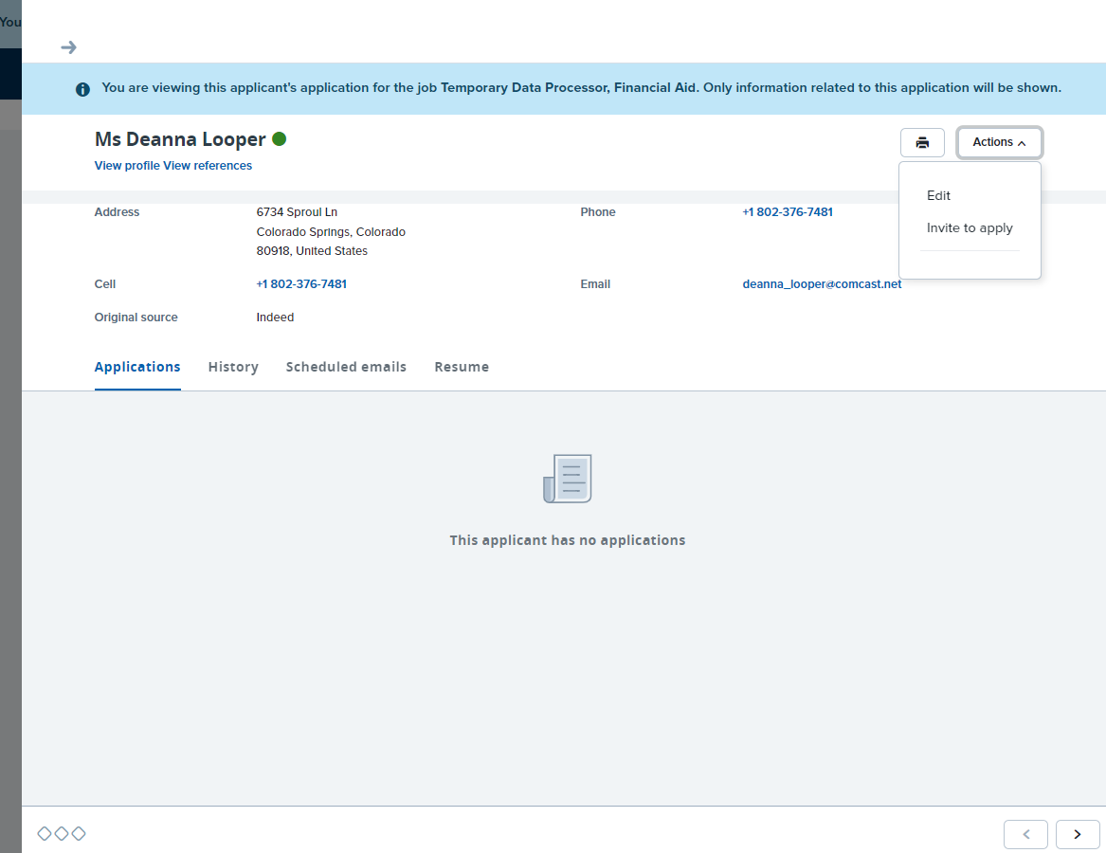
Viewing & managing applicants cont.
Utilize the arrows on the bottom right corner to easily move through the applicant pool.

Slide 25
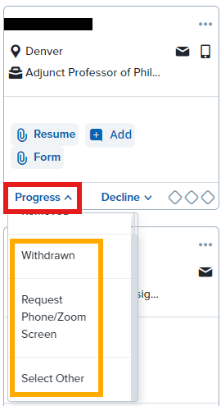
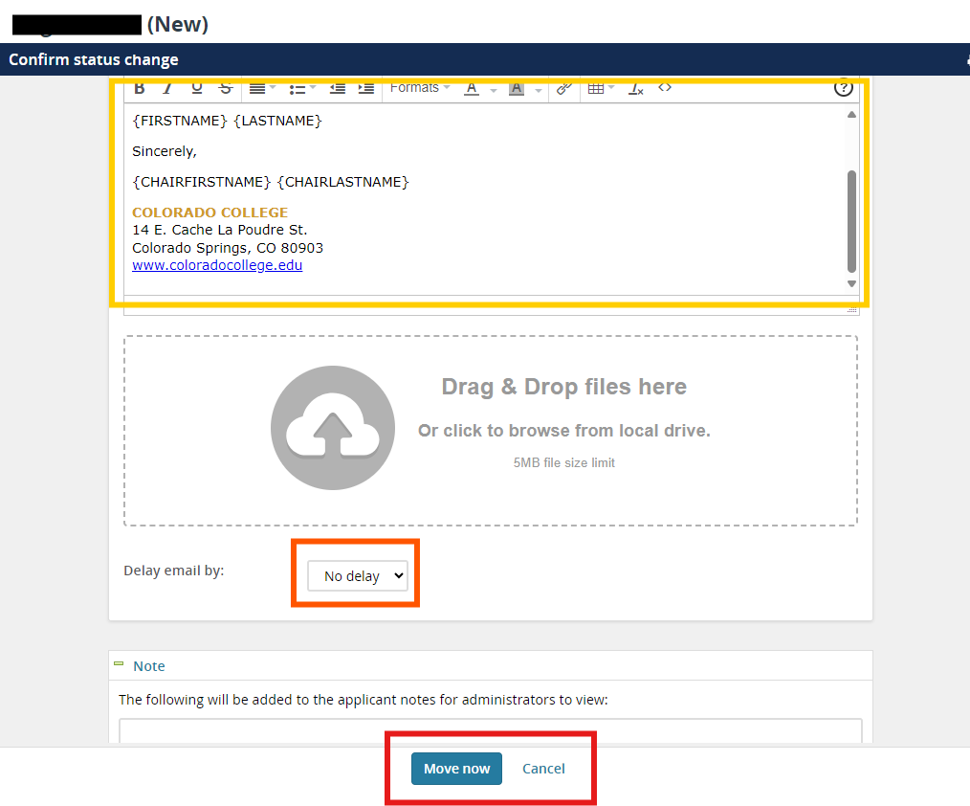
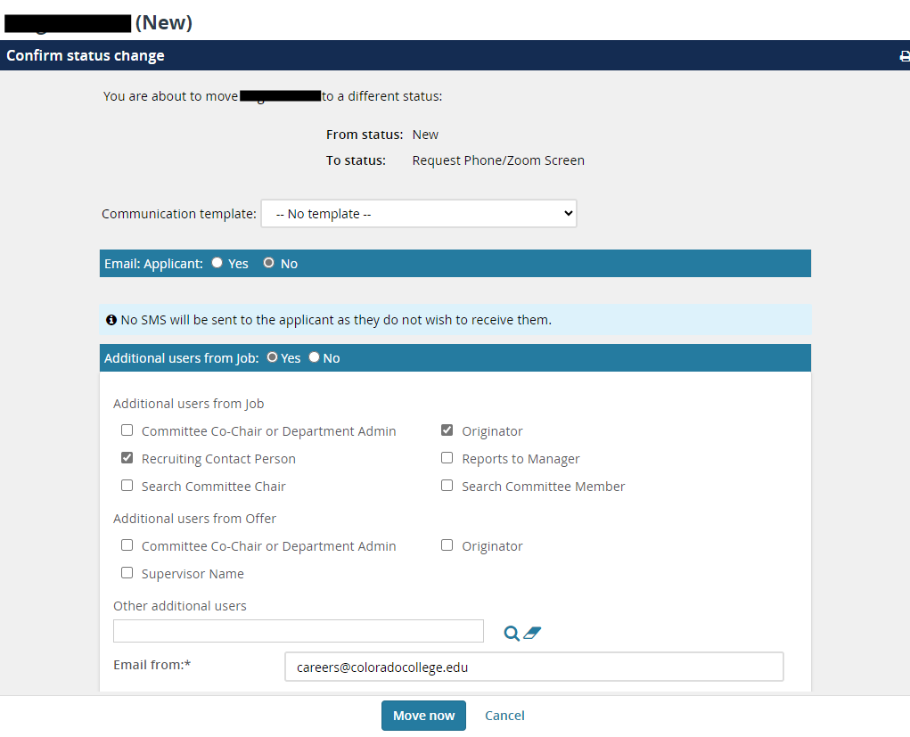
Interviewing Candidates
To move a candidate through the workflow, click on the drop-down and choose either the immediate actions, or you can send specific communication through "Select Other". Here, you can choose an email template and confirm the status change.

Slide 26
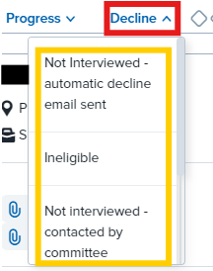
Interviewing Candidates cont.
Be sure to pay close attention to the workflow actions that send out automated emails.
It's encouraged to continue to move your candidates through the workflow with each stage. This will keep yourself and your search committee aligned as to what stage you are in with a candidate. Continue to use your best personal method of scheduling phone and Zoom interviews.

Slide 27
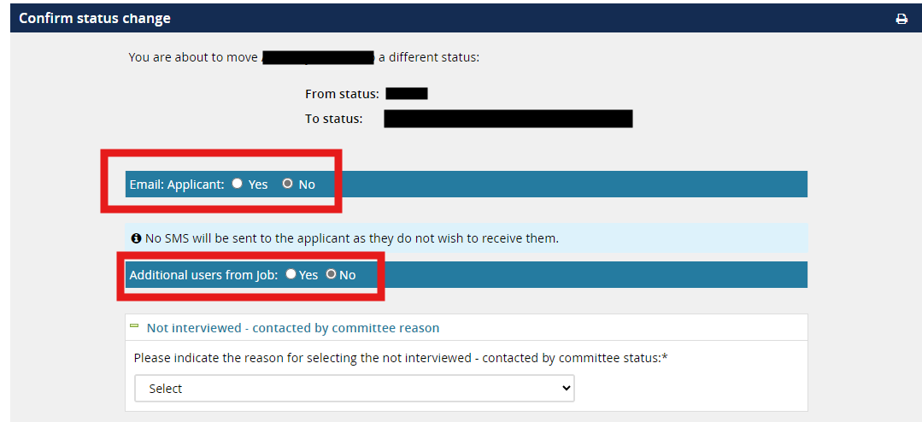
Dispositioning Candidates Tip
For any status change, be sure to pay special attention to who will be notified. Some status updates will require you to notify the candidate, other changes will not. The same goes with "Additional Users" as well.

Slide 28
PageUp User Guide
Launching an Offer Card
Human Resources Department
People and Workplace Culture
Notes:
Note, these pptx modules are to be viewed from the perspective of the hiring manager.

Slide 29
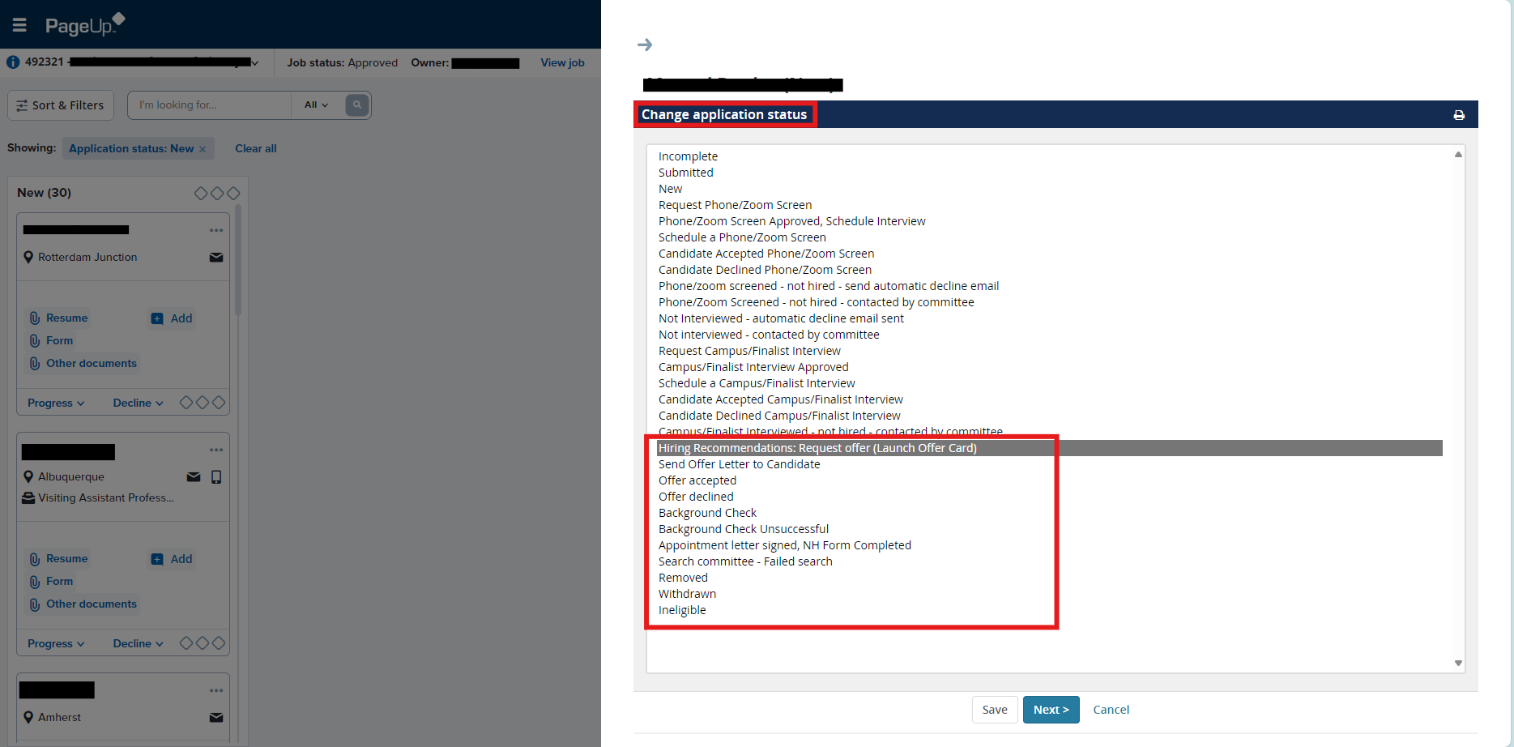
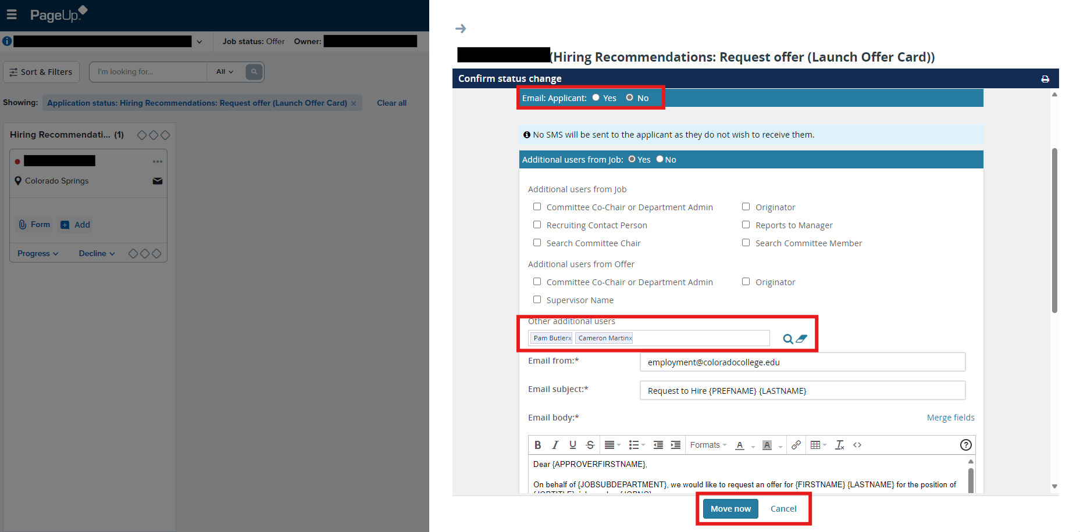
Launching an offer card
Congratulations on getting ready to extend an offer!
To get started, click on your decided candidate and select "Hiring Recommendations: Request offer (Launch offer card)" from the "Progress" dropdown. In the "Other additional users" box, be sure to include the compensation team (Pam Butler and Cameron Martin) to request an offer suggestion.
Select "Move now" to send the request.

Slide 30
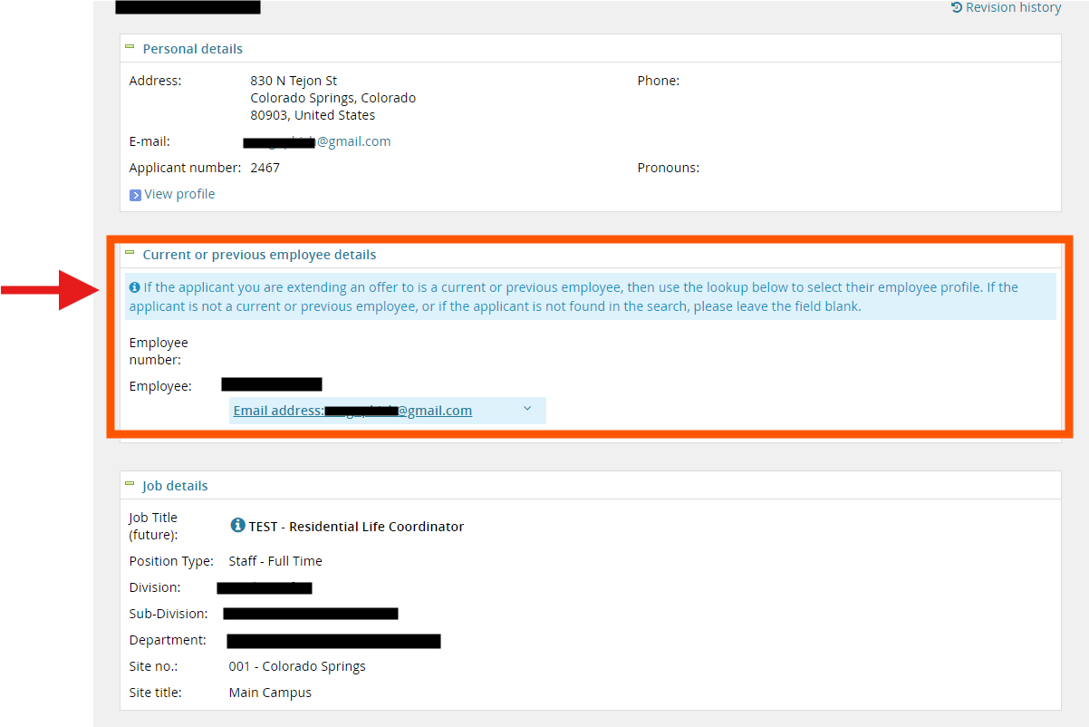
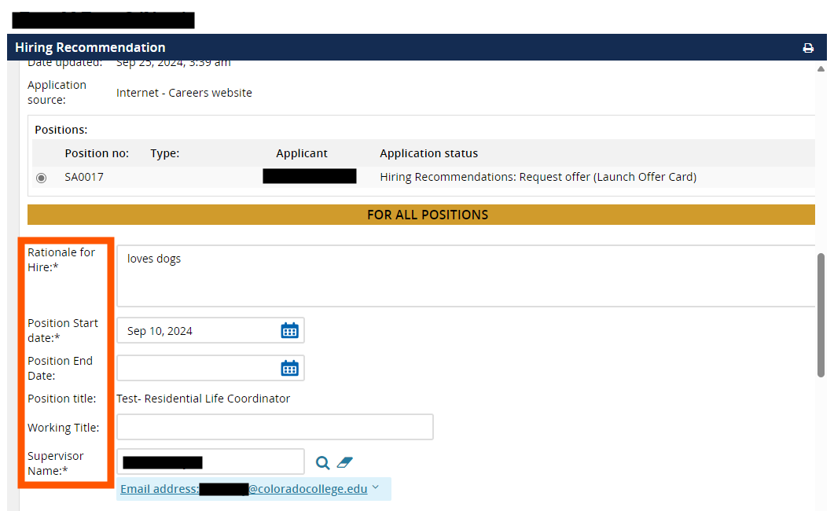
Launching an offer card cont.
Add in rationale for hire, anticipated start date, and any other required/asterik marked areas.
Be sure to confirm if the candidate is a current, previous, or new CC associate!

Slide 31
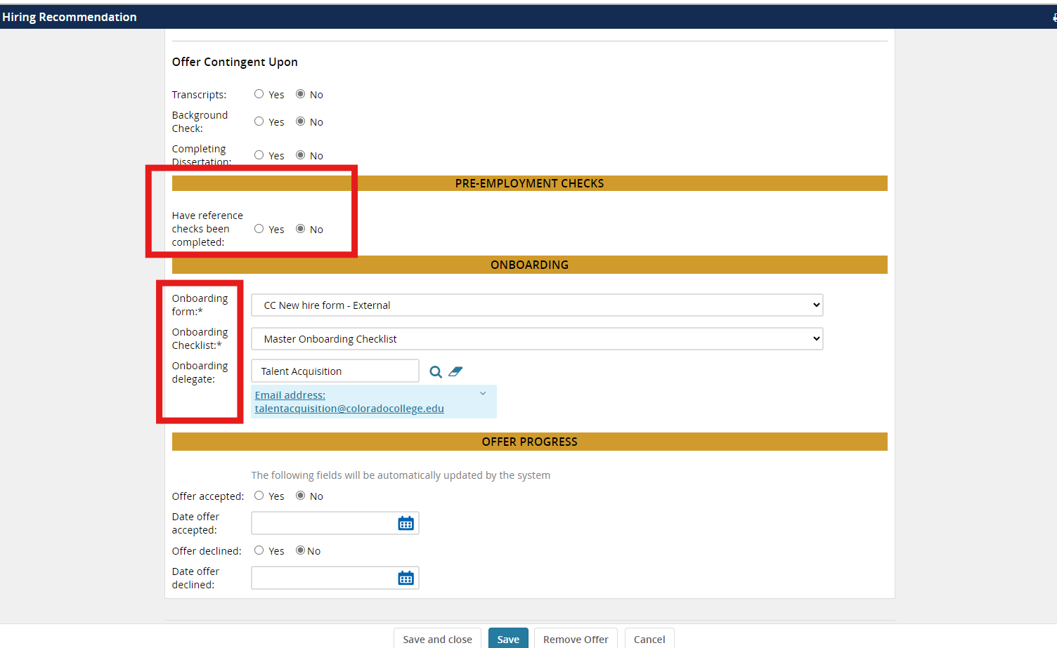
Launching an offer card cont.
Continue to fill out any required areas on the offer card.
Reference checks and interview notes can be uploaded in the "Other Documents" section by clicking on "Add Document".

Slide 32
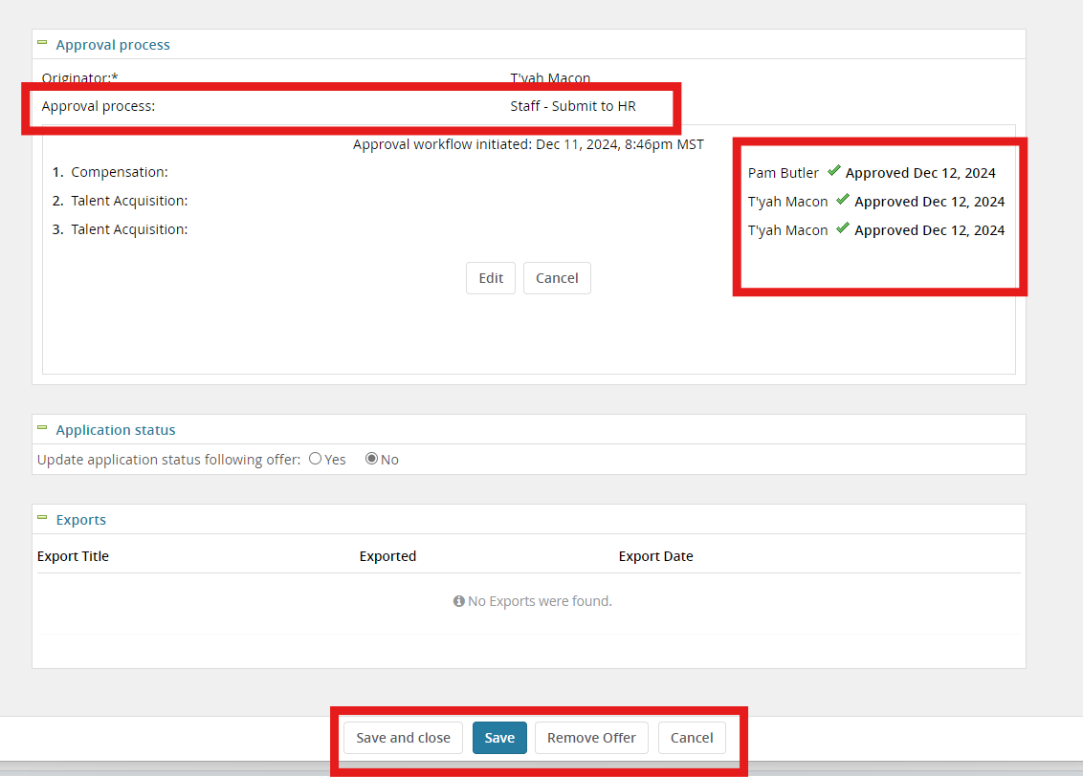
Launching an offer card cont.
At the very bottom of the screen within "Approval Process", select from the drop down as "Staff – Submit to HR". You should then see the approval process go through Pam Butler and hen T'yah Macon. If the approval process is not selected, this will hold the offer card without notifying anyone.
Click "Save" to formally launch the offer card.

Slide 33
PageUp User Guide
Finalizing a Search & Extending an Offer
Human Resources Department
People and Workplace Culture
Notes:
Note, these pptx modules are to be viewed from the perspective of the hiring manager.

Slide 34
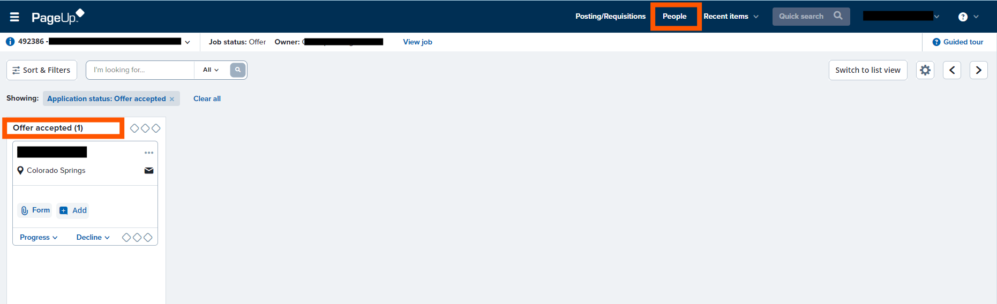
How to Check Candidate Status
To check on the status of the new hire during their onboarding phase, click on "People" in the upper-right hand side of the banner. You should can see the selected candidate here.

Slide 35
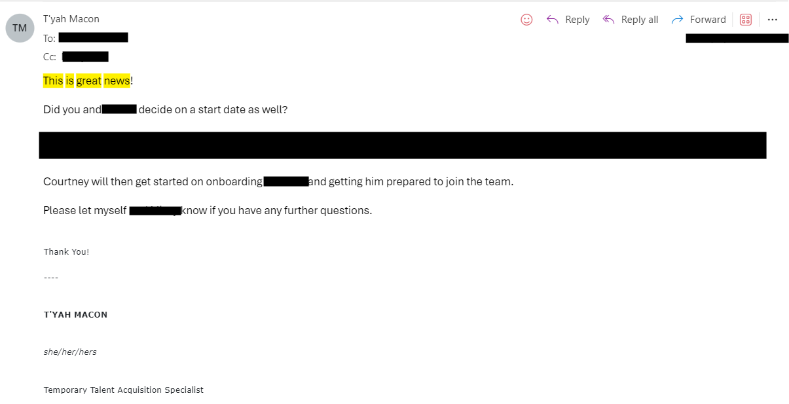
Making the Offer and Start Onboarding
The TA Spec. will reach back out to the hiring manager via email confirming the compensation to offer.
The Hiring manager will verbally offer to candidate and if accepted the HR team will update workflow status, start their Onboarding phase, as well as communicate with the new hire on next steps.
As you begin to close out your search, be sure to disposition the reaming candidates that you are rejecting or keeping on standby as a runner-up in case the initial offer falls through for any reason.

