Slide 1
Banner Capital Equipment Request Process Guide

Slide 2
General Guidelines
The Capital Committee
Who does what?
Timeline
Purchasing
Using Self Service Banner (SSB) to request capital equipment

Slide 3
Each year, individual departments are given the opportunity to reallocate their operating budgets.
Included in this process:
Budget reallocation for fund 110002, Unrestricted Operating Accounts (7XXXXX)
Not included in this process:
Budget reallocation for labor
Additional funds awarded
Approved roll-forward funds
Any other non-operating accounts
All accounts that do not qualify for this process will be added or reallocated by the Budget Office.
General Guidelines
Each year, individual departments are given the opportunity to request funds for the purchase of capital equipment.
Included in this process:
Equipment (office furniture, lab equipment, grounds equipment, etc.) costing more than $1,000 per item.
Not included in this process:
Equipment (calculators, digital cameras, office chairs, etc.) costing less than $1,000 per item or deemed disposable. These items are to be purchased using operating funds.
Requests for computers and smart classroom equipment. These items are to be requested through ITS.

Slide 4
General Guidelines (continued)
Request each item separately.
Assign a priority to each request.
Funds awarded must only be used to purchase approved items.
Consider whether your capital equipment will require installation, and if so, remember to submit a Renewal & Replacement (R&R) request through facilities.
Approved requests must be purchased and received within the fiscal year.
Roll forwards are not available for this program.

Slide 5
Each year, individual departments are given the opportunity to reallocate their operating budgets.
Included in this process:
Budget reallocation for fund 110002, Unrestricted Operating Accounts (7XXXXX)
Not included in this process:
Budget reallocation for labor
Additional funds awarded
Approved roll-forward funds
Any other non-operating accounts
All accounts that do not qualify for this process will be added or reallocated by the Budget Office.
Capital Committee
The Capital Committee is comprised of multiple co-chairs to include:
Representation from the Budget Office
Representation from the Provost’s Office
Representation from the Facilities Office
And when needed, consultation with the Office of Information Technology
Together, the committee gathers, reviews, evaluates, and makes award recommendations to ensure a fair and equitable process.

Slide 6
Who does What?
Departments
Identify departmental needs and priorities
Consult with the Budget Office as needed
Submit Requests on time
Capital Committee
Evaluate each request
Make recommendations as needed
Communicate approvals

Slide 7
Timeline
April
Capital Equipment Portal opens
April
Capital Equipment Portal closes
April - May
Capital Committee reviews requests and drafts recommendations
Awarded capital funds are available
Departments gather and prioritize requests
Departments create and submit requests into the Capital Equipment Portal
Budget Office notifies departments of approvals
July 1

Slide 8
Each year, individual departments are given the opportunity to reallocate their operating budgets.
Included in this process:
Budget reallocation for fund 110002, Unrestricted Operating Accounts (7XXXXX)
Not included in this process:
Budget reallocation for labor
Additional funds awarded
Approved roll-forward funds
Any other non-operating accounts
All accounts that do not qualify for this process will be added or reallocated by the Budget Office.
Purchasing Guidelines
Ensure you consider lead time on all purchases.
You should receive all capital equipment on campus before the end of the fiscal year.
Do not spend more than the approved purchase amount.
Please contact the Budget Office if you run into any issues with pricing, as expenditures more than the submitted purchase amount must be approved in advance and covered by the department’s operating budget.

Slide 9
Using Self-Service Banner (SSB) to Request Capital Equipment

Slide 10
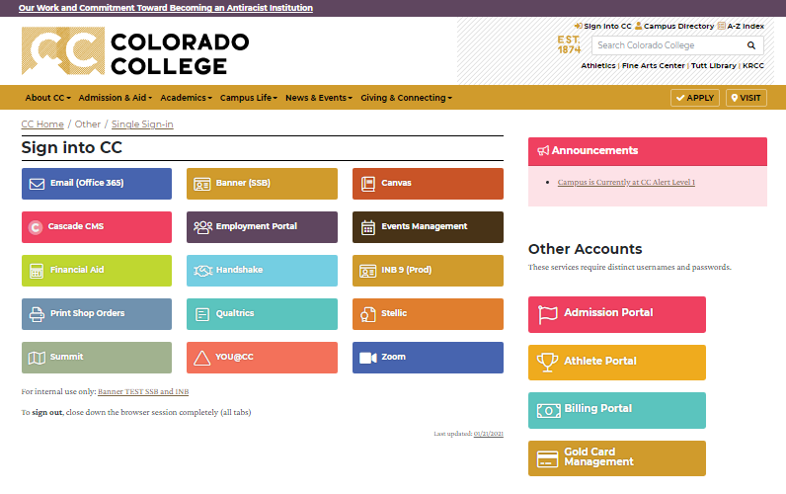
Sign in to Colorado College and select Banner (SSB).

Slide 11
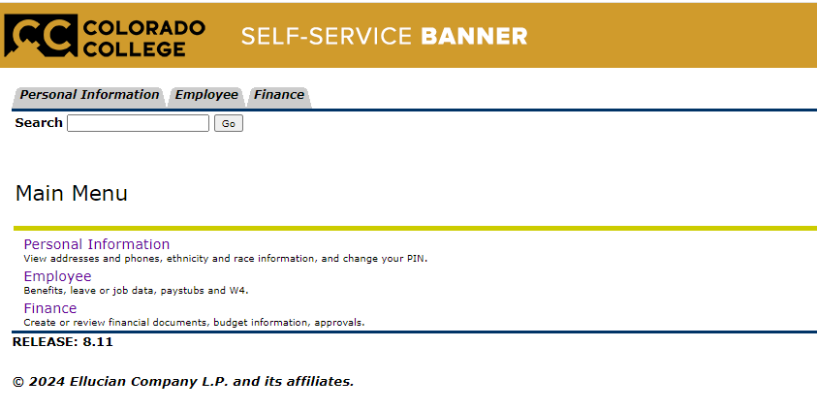
From the top of the page, select the Finance tab. Or, select Finance under the main menu.

Slide 12
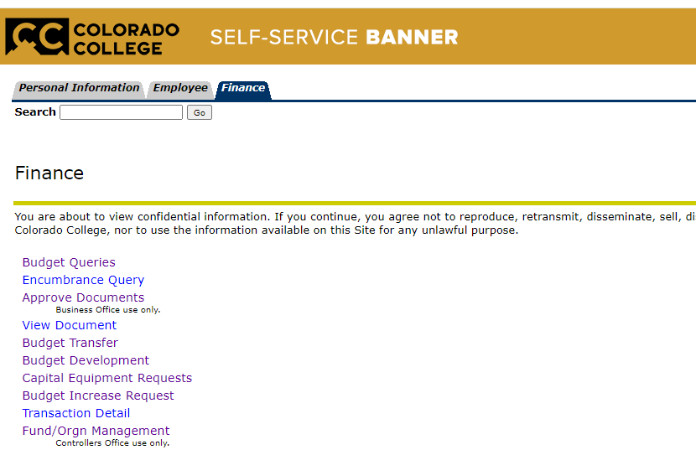
Select Capital Equipment Requests.

Slide 13
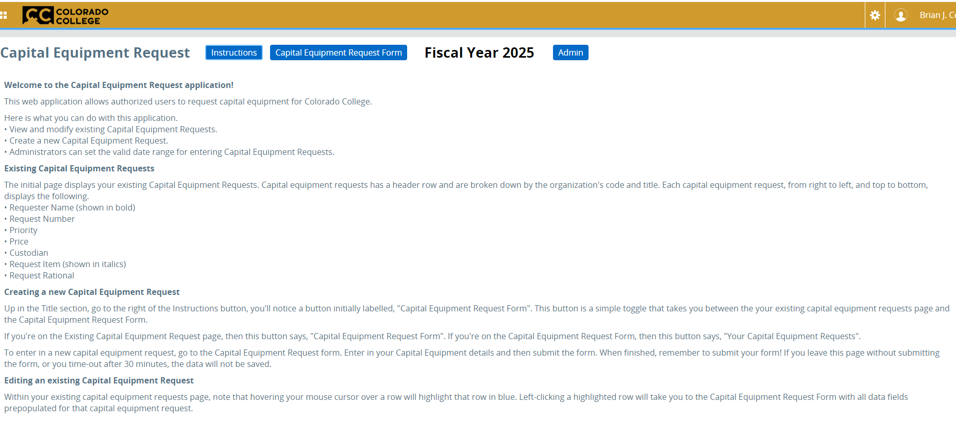
1. Select Instructions for an overview of the Capital Equipment Request Application.
2. Select the Capital Equipment Request Form to begin a new request.

Slide 14
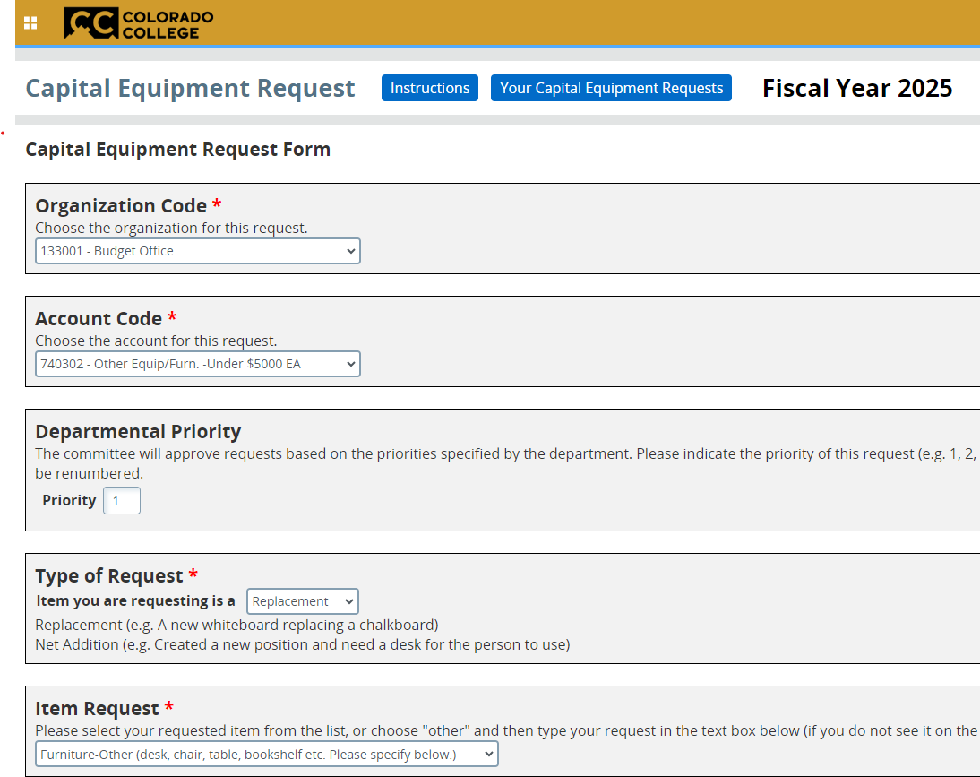
Choose the org code that applies to the request. Only those org codes assigned to your account will be visible here.
Choose the account code that applies to the item you are requesting.
Make sure each request is assigned a unique priority. Do not assign the same priority to multiple requests or the system will re-number each item.
Identify if this is a new/net addition request or a request to replace an existing item.
Select the requested item. Or, if not shown, select Other.

Slide 15
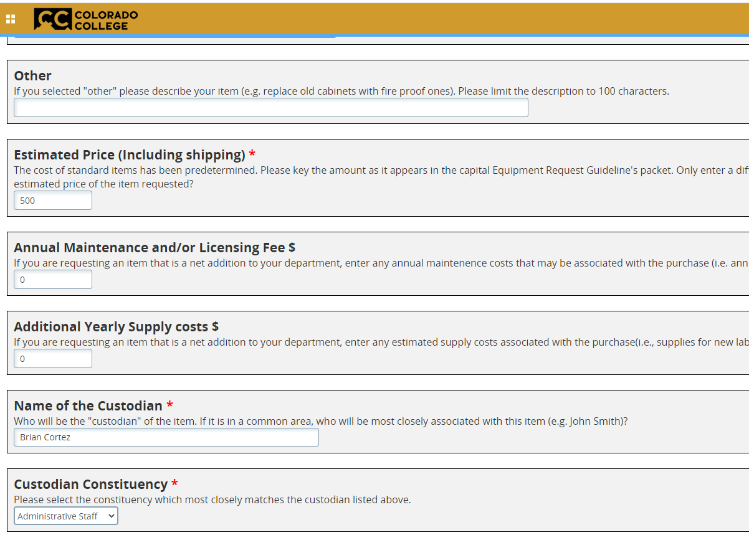
If you selected “Other”, clearly describe your request.
Enter the exact item price, including shipping. If unknown, enter your very best estimate.
Enter Annual Maintenance, Licensing, and Additional Yearly Supply costs if applicable.
Enter the person associated with, or directly accountable for, the request and their associated constituency (Staff, Faculty, Student, etc.)

Slide 16
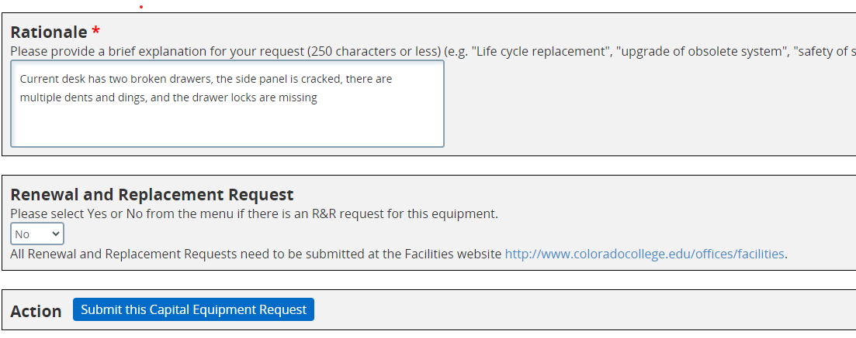
In 250 characters or less, describe the reason for the request.
If the answer to this question is yes, submit a Renewal and Replacement request at the Facilities website.
Submit the request. You will be prompted to confirm. Select Ok.

Slide 17
To create another request, click on the Capital Equipment Request Form again to be taken back to the input screen.

Slide 18
Update or Delete a Capital Request

Slide 19
On the main screen, select the request to be updated or deleted.

Slide 20
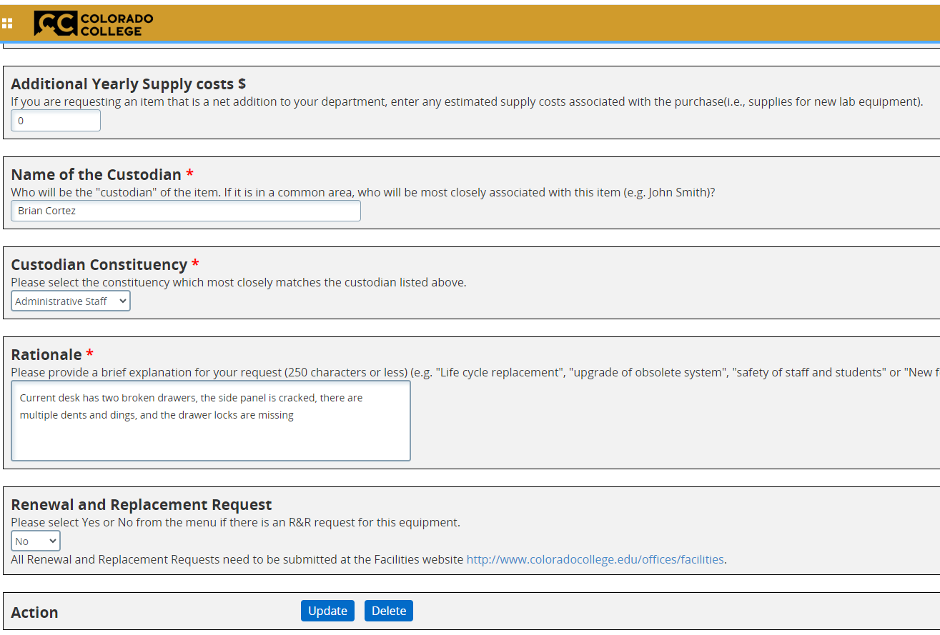
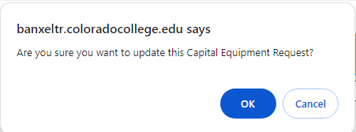
Make necessary updates. Scroll to the bottom of the page and select either Update or Delete. Just as with Submit, you will be prompted to confirm your response.

Slide 21
Thank you!

Slide 22
Need Help?
Call or email
Brian Cortez x6854
bcortez2024@coloradocollege.edu
or
Mateo Munoz x6051
mmunoz@coloradocollege.edu

